Slide 1
Introduction to Medication Assisted Treatment
Michael Dulitz, MPH, NRP
Opioid Response Project Coordinator

Slide 2
Foundation
Addiction is a chronic relapsing brain disease characterized by compulsive use of a substance despite negative consequences
Despite being a chronic disease, addiction is treatable, and individuals can enter remission
Addiction is more common than we see, 10% of adults meet the criteria for a substance use disorder in their lifetime. Only 25% of those that met the criteria for a use disorder ever received care.

Slide 3
Addiction is a brain disease
Substances that cause addiction primarily work on 2 receptor types
Dopaminergic
Opioid (primarily the mu receptor)
Neurotransmitters
Dopamine
Opioids
Endorphins (endogenous opioids)
Exogenous (introduced from outside)
Stimulants
Dopamine
Opioids
Opioid receptor stimulation
Alcohol
Endorphins
Reward/Dependence/
Loss of Control
Substance Use Disorder/
Addiction

Slide 4
Addiction is a brain disease
When we do things that help us survive, we release neurotransmitters
These neurotransmitters create a feeling of wellbeing and create trigger memory creation
Receptors for these transmitters are located throughout the body, but substance use disorders affect:
Limbic system
basic survival instincts
Prefrontal cortex
decision making and impulse control

Slide 5
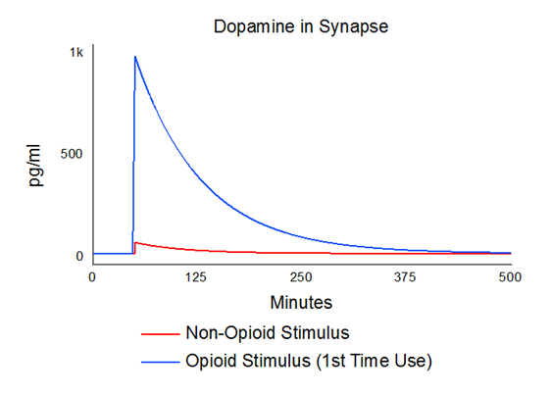
Dopamine/Endorphin model
Life affirming activities produce a small spike of dopamine
~50% increase with eating
~100% increase with sex
Dopamine levels between 50-100 pg/mL at baseline
Substances spike this dopamine level
Morphine ~300% increase
Heroin ~1,000% increase
Methamphetamine ~900-1,000% increase

Slide 6
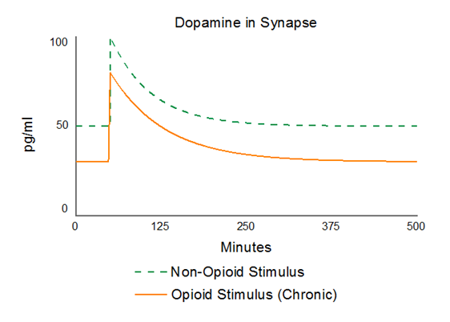
Dopamine/Endorphin model
With chronic use, the brain adjusts to the new normal.
Decreases baseline dopamine production
Creates more dopamine receptors
Result: brain needs more of the substance to generate the same response
Life affirming activities do not create enough dopamine to trigger proper brain function, impulse control is also lost
The individual will do whatever is needed to obtain the substance

Slide 7
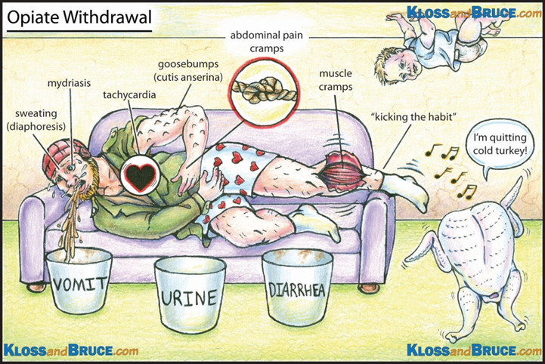
Dopamine/Endorphin model
With chronic use, objective eventually becomes to find enough of the substance to feel normal and avoid withdrawal
When substance is not present, physical withdrawal occurs
Memory
Loss of memory cues
Charlie Brown Effect

Slide 8
Dopamine/Endorphin model
Objectives of Agonist-based Medication Assisted Treatment for Opioid Use Disorder
Return the brain to a normal baseline dopamine level
Use long-acting medication to prevent spikes in dopamine
Stop cravings for a substance
Allow the addressing of psychosocial needs
Three FDA Approved Medications for OUD
Methadone – Full agonist
Buprenorphine – Partial agonist
Naltrexone - Antagonist

Slide 9
Dopamine/Endorphin model
High dopamine recovery
Low dopamine recovery
Individuals with strong recovery supports
Highly motivated to enter treatment
Predictable recovery path
Most addiction treatment success data is from these groups
May do well with abstinence based treatment
Unmet psychological, social, or economic needs
Unaddressed ACEs or other trauma
Uncertain recovery supports
Low treatment retention rates in traditional or abstinence based treatment
Best candidates for medication assisted treatment

Slide 10
Dopamine/Endorphin model
Lack of dopamine drives common behaviors seen in addiction
This allows cravings to be stabilized
Allowing for behavioral therapy to be effective
Augmentation of dopamine is logical in a disease process related to dopamine deficiency
We have FDA approved medications to safely increase dopamine

Slide 11
Methadone
Full opioid receptor activation
Treatment goal: Activate the opioid receptors to the point that the individual does not experience opioid cravings, is not in withdrawal, and is not experiencing euphoria.
Duration of action: 1-2 days
Can only be provided through Opioid Treatment Programs (OTPs)
Closest in Fargo (3-4 people drive daily from Grand Forks)
Must dose in person and earn privileges
Prevents diversion
Liquid form used almost exclusively in OTPs

Slide 12
Methadone
Oldest and most studied medication for opioid addiction.
Ideal candidates:
Individuals with exceptionally high opioid use histories
Individuals with treatment retention difficulties
Individuals who were unable to tolerate buprenorphine treatment
Large barriers to treatment in Grand Forks due to a lack of OTPs

Slide 13
Methadone
“Loaded”
“High”
“Abnormal Normality”
Dose Response
Normal Range “Comfort Zone”
Subjective withdrawal
“Sick”
Objective withdrawal
Time
0 hrs.
24 hrs.

Slide 14
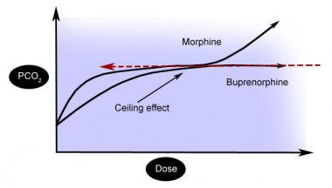
Buprenorphine
Partial receptor activator
Treatment goal: Activate the opioid receptors to the point that the individual does not experience opioid cravings and is not in withdrawal.
Duration of Action: ~24 hours
Sublingual tablet, dissolves in 10-20 minutes, onset of action in 30 minutes
Very high affinity for receptor sites
Will kick most existing opioids off their receptor -> Precipitated withdrawal
Ceiling effect – very safe for opioid tolerant individuals

Slide 15
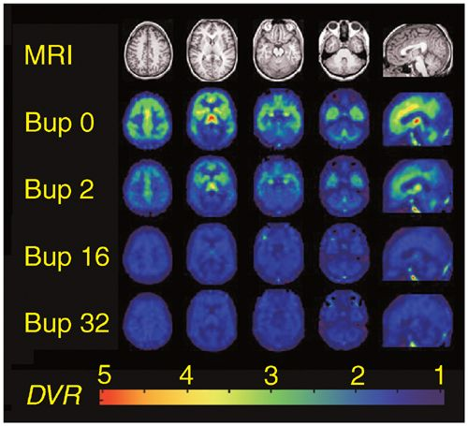
Buprenorphine
Oftentimes combined with naloxone to prevent injection use
Common Forms:
Subutex (buprenorphine) sublingual tablet - > Pregnant women
Suboxone (buprenorphine/naloxone) sublingual film - > Most Common
Zubsolv (buprenorphine/naloxone) sublingual tablet - > NDMA
Sublocade (buprenorphine) extended release injection - > New to market, $$$$
High dose buprenorphine more effective than low dose buprenorphine in maintaining long-term treatment retention

Slide 16
Buprenorphine
Only DATA 2000 Waivered prescribers can prescribe this medication
Treatment initiation
Must be started when in mild withdrawal – generally 8-16 hours from last opioid use
Initial dose typically 4-8mg, up to 16mg
3-4 day follow up, then titrate dose up
Optimal maintenance dose 8-24mg
Treatment course
Individually designed taper – 6 months – lifetime
Continued reassessment, titrate to opioid cravings
Last 2 mg reported to be most difficult

Slide 17
Naltrexone
Full receptor antagonist, reverses and caps the opioid receptor
Structurally similar to naloxone
Treatment goal: Remove the ability to use a substance by removing the euphoric effects of taking the substance
FDA approved for opioid addiction and alcohol addiction
Available as a oral tablet and as an extended release injectable (Vivitrol)
Oral form is cheap, but has low treatment compliance
Injectable form is expensive, but increases treatment compliance (28 days/injection)

Slide 18
Naltrexone
In one major study, extended release naltrexone is similar to buprenorphine or methadone in treatment retention
BUT:
Fewer received the first dose of Naltrexone (failed before initiating study)
7-10 day opioid free period required
Relapse more likely in intention to treat analysis
More overdoses, fewer fatal overdoses though
Less treatment retention after study period

Slide 19
Naltrexone
Ideal candidates for extended release naltrexone
Individuals who are highly motivated and well supported in their recovery
Safety net
Individuals who continue to work in professions which prohibit the use of other MAT medications
Airline pilots/Physicians
Individuals who have already gone through a opioid detoxification period and/or are opposed to opioid agonist therapy
Individuals with alcohol use disorder

Slide 20
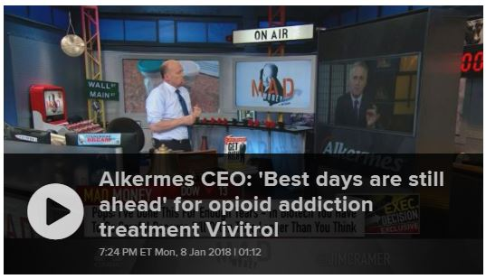
Naltrexone
Dopamine and naltrexone
Naltrexone does not assist in returning the body to its baseline dopamine level – “normal feeling”
Opioid cravings may persist despite inability to use opioids for euphoria
Naltrexone inhibits endorphins from acting in the body resulting in a dull affect
Depression
Bottom line
Vivitrol has definite value for select clients, but is not the no-brainer it seems at face value, though for some it is the best solution
Alkermes heavily markets Vivitrol to abstinence based providers, jails, drug courts, and governments

Slide 21
Nicotine use disorder
Medication assisted treatment readily available for nicotine use disorder
Nicotine replacement
Provides a baseline level of nicotine to prevent cravings and withdrawal
Allows the individual to address the factors that lead to smoking and reprogram behaviors associated with smoking
Other medications
Chantix (varenicline)
Wellbutrin (buproprion)
Individuals are more successful in recovery when they quit smoking at the same time

Slide 22
Treatment
Addiction is a complex but treatable disease that affects brain function and behavior. Treatment needs to be readily available and attend to the multiple needs of the individual. No single treatment is appropriate for everyone.
Group-based peer support – Treatment philosophies vary!
Narcotics Anonymous (NA) /AA
SMART Recovery – Non 12-step
Faith-centered
Recovery housing
Individual-based peer support
Employer supported – Face It TOGETHER
Re-entry programs – Free Through Recovery
Program supported – Human Service Agencies
Peer to peer
Peer Support
Medication
Assisted
Treatment
Counseling
ASAM criteria guide level of care
Outpatient (<9 hrs/week)
High-Intensity Outpatient (9-20 hrs/week)
Partial hospitalization (20-40 hrs/week)
Residential Treatment (Clinically or Medically Managed)
Intensive Inpatient (24-hour nursing and physician care)
Methadone – Mu Opioid Agonist
Buprenorphine –Partial Mu Opioid Agonist
Suboxone/Zubsolv (Sublingual)
Sublocade (28 day injectable)
Naltrexone – Mu Opioid Antagonist
Vivitrol (28 day injectable)

Slide 23
How do we properly treat addiction?
Assess severity of the substance use disorder
Control over substance use
How substance use affects your life
Symptoms of physical dependence
ASAM guidelines
Level 0.5 – At Risk
Level 1 – Mild SUD
Level 2 – Moderate SUD
Level 3 – Severe SUD
Severity and level helps to dictate the most appropriate treatment

Slide 24
How do we properly treat addiction?
The more severe the disorder, the more intense level of treatment is needed
Start at the level corresponding to need
Level 3 – Residential or inpatient
Level 2 – Intensive outpatient
Level 1 – Outpatient services
Level 0.5 – Early intervention
More treatment isn’t better treatment if it doesn’t match the patient’s need
Most of this treatment is available locally on an outpatient basis or in-state.

Slide 25
Opioid Response in Grand Forks
Empowering the Individual | Eliminating Barriers | Enabling Recovery
Treatment
Addiction is a complex but treatable disease that affects brain function and behavior. Treatment needs to be readily available and attend to the multiple needs of the individual. No single treatment is appropriate for everyone.
F5 Project
Face It TOGETHER
Assist reentry and provide peer support for individuals involved in the criminal justice system
$10,000
Build peer support capacity using their sustainable peer support model
$29,000
Peer Support
Medication
Assisted
Treatment
Counseling
Agassiz Associates
Valley Community Health Centers
Provide treatment services to inmates at Grand Forks County Correctional Center
$29,000
Increase access to medication assisted treatment
$79,000

Slide 26
Future concerns

Slide 27
Questions?
 | 2014 | 2015 | 2016 | 2017 | 2018
Opioid Overdoses | 22 | 27 | 63 | 53 | 30
Monthly Average – Opioid Overdoses | 1.8 | 2.3 | 5.3 | 4.4 | 2.5
Months without a reported Opioid Overdose | 2 | 1 | 0 | 0 | 1

